Slide 1

Architecture Concepts Based on Change Data Capture
Mateusz Dymiński

Slide 2
whoami
Mateusz Dymiński
Software Developer at Nokia
8+ exp with Java
5+ exp with Go
One of the organizer GoWroc - Golang Wroclaw Meetup
Page: https://mateuszdyminski.com
Github: github.com/mateuszdyminski
Twitter: @m_dyminski
LinkedIn: linkedin.com/in/mdyminski

Slide 3
Agenda
Change Data Capture
Turning on CDC in DB
CDC Tooling
Architecture Concepts
Streaming
Microservices Communication
Outbox Pattern
Strangler Pattern
CDC challenges
Summary

Slide 4
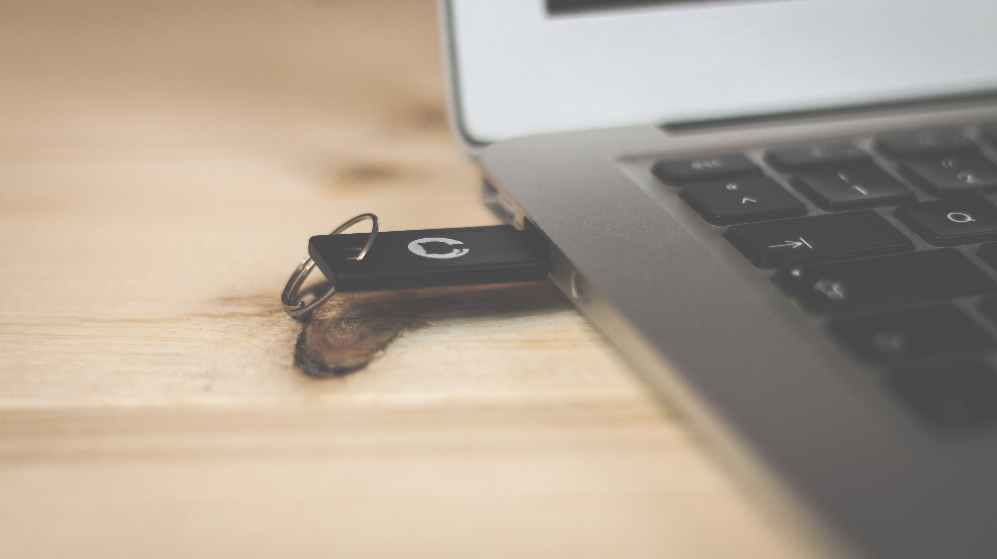
github.com/mateuszdyminski/cdc

Slide 5

Change Data Capture

Slide 6
Change Data Capture
change data capture (CDC) is a set of software design patterns used to determine and track the data that has changed so that action can be taken using the changed data.

Slide 7
Types of Change Data Capture
Trigger-based CDC
Query-based (polling) CDC
Log-based (WAL, Redo logs, Binlog) CDC

Slide 8
Trigger-based Change Data Capture
DBs provide trigger functions to performing user-defined actions once events, like insertions of data, occur
Trigger could copy records which have changed in a separate table used as an event queue
It requires recurring polling of the event table
Vendor-specific code for implementing trigger

Slide 9
Query-based Change Data Capture
Every X seconds we need to query DB to get changes
Slows down the DB due to often heavy queries
Requires recurrent polling of the table
Determining the difference between two data sets is a compute-heavy operation that makes frequent executions impossible

Slide 10
Log-based Change Data Capture
Based on WAL, Redo logs, Binlog
All data changes are captured
No polling or overhead
Transparent – no need to touch any of old/legacy applications
Event with changes is sent to subscribers
Reactive approach

Slide 11
SQL
CREATE TABLE users (
id SERIAL PRIMARY KEY,
firstname TEXT NOT NULL,
lastname TEXT NOT NULL,
created_at TIMESTAMP DEFAULT NOW()
);

Slide 12
Following INSERT
INSERT INTO users(firstname, lastname) VALUES('Johny', 'Rambo');
Produces following EVENT
{
"change": [
{
"kind": "insert",
"schema": "public",
"table": ”users",
"columnnames": [”id”, ”firstname", ”lastname", "created_at"],
"columntypes": [
"integer",
”text",
”text",
"timestamp without time zone"
],
"columnvalues": [1, ”Johny", ”Rambo", "2020-09-15 11:58:28.988414"]
}
]
}

Slide 13
Following UPDATE
UPDATE users SET lastname = 'Kowalski' WHERE id = 1;
Produces following EVENT
{
"change": [
{
"kind": "update",
"schema": "public",
"table": "users",
"columnnames": ["id", "firstname", "lastname", "created_at"],
"columntypes": ["integer", "text", "text", "timestamp without time zone"],
"columnvalues": [1, "Johny", "Kowalski", "2020-09-15 11:58:28.988414"],
"oldkeys": {
"keynames": ["id"],
"keytypes": ["integer"],
"keyvalues": [1]
}
}
]
}

Slide 14
Following DELETE
DELETE FROM users WHERE id = '1';
Produces following EVENT
{
"change": [
{
"kind": "delete",
"schema": "public",
"table": "users",
"oldkeys": {
"keynames": ["id"],
"keytypes": ["integer"],
"keyvalues": [1]
}
}
]
}

Slide 15
Turning on CDC in DB

Slide 16
To allow CDC(log-based) in Postgres
Set wal_level = logical
Set max_replication_slots > 1
Postgres version > 9.4

Slide 17
To allow CDC(log-based) in MySQL
Run MySQL with binlog-format set to row
[mysqld]
log_bin = /var/log/mysql/mysql-bin.log
max_binlog_size = 100M
binlog-format = row

Slide 18
CDC on Cloud Providers
In most cases you can use CDC with DBs provided by cloud providers
There are some problems with CDC on GCE

Slide 19

Demo

Slide 20

CDC Tooling

Slide 21
Debezium
The most popular CDC platform
CDC with multiple databases support
Based on transactional logs
Snapshotting
3 modes of operation:
Kafka connect
Debezium server
Embedded
Opensource: https://github.com/debezium/debezium
Created by RedHat
Battle tested
But https://github.com/alibaba/canal has 4x stars on Github

Slide 22
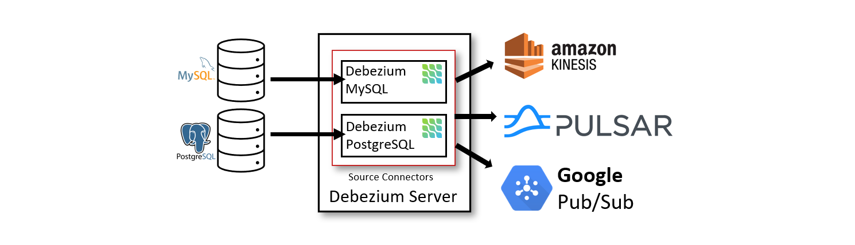
Debezium – Server
Source: https://debezium.io/documentation/reference/1.2/architecture.html

Slide 23
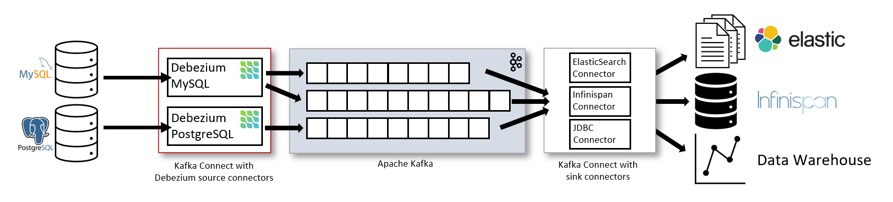
Debezium – Kafka Connect
Source: https://debezium.io/documentation/reference/1.2/architecture.html

Slide 24
Debezium – Embedded
Library embedded into your Java app
Consuming change events within your application itself
No need to deploy Kafka

Slide 25
Debezium – supported databases
MongoDB
MySQL
PostgreSQL
SQL Server
Oracle (Incubating)
Db2 (Incubating)
Cassandra (Incubating)

Slide 26


Slide 27
Kafka
Apache describes Kafka as a distributed streaming platform that lets us:
Publish and subscribe to streams of records.
Store streams of records in a fault-tolerant way.
Process streams of records as they occur.

Slide 28
Debezium alternatives
https://github.com/zendesk/maxwell
https://github.com/airbnb/SpinalTap
https://github.com/Yelp/mysql_streamer

Slide 29
More alternatives - MySQL
aesop https://github.com/Flipkart/aesop
databus https://github.com/linkedin/databus
FlexCDC http://github.com/greenlion/swanhart-tools/
Lapidus https://github.com/JarvusInnovations/lapidus
mypipe https://github.com/mardambey/mypipe
MySqlCdc https://github.com/rusuly/MySqlCdc
mysql-binlog-connector-java https://github.com/shyiko/mysql-binlog-connector-java
oltp-cdc-olap https://github.com/xmlking/nifi-examples/tree/master/oltp-cdc-olap
Open Replicator https://code.google.com/p/open-replicator/
Canal https://github.com/alibaba/canal
python-mysql-replication https://github.com/noplay/python-mysql-replication
recordbus https://github.com/pyr/recordbus
Tungsten Replicator https://github.com/continuent/tungsten-replicator
wombat https://github.com/TiVo/wombat
kafka-mysql-connector https://github.com/wushujames/kafka-mysql-connector
php-mysql-replication https://github.com/krowinski/php-mysql-replication
StreamSets Data Collector https://streamsets.com/products/sdc/
Source: https://github.com/wushujames/mysql-cdc-projects/wiki

Slide 30
New player on the market - DBLog
New alternative for Debezium created by Netflix
Not opensourced yet, but should be in 2020
Some features:
Dumps can be taken anytime
No locks on tables
Designed to perform Snapshots quite often
More info: https://netflixtechblog.com/dblog-a-generic-change-data-capture-framework-69351fb9099b

Slide 31

Architecture Concepts Based on CDC

Slide 32

Streaming

Slide 33

Streaming
Legacy App
DB

Slide 34

Streaming
Legacy App
DB
ElasticSearch
CDC

Slide 35
Microservices Communication

Slide 36
Data Synchronization
Analytics DB
Insert
Create New Account
Users Service
Insert
DB
Insert
ElasticSearch
BAD DESIGN

Slide 37
Data Synchronization
Create New Account
Users Service
Insert
DB
Propagate data between different
services without coupling
Inserted User
Inserted User
CDC
Inserted User
Inserted User
Audit DB
Kafka Connect Sink Connector
Analytics Service
Analytics DB

Slide 38
Outbox pattern

Slide 39
Outbox pattern
Problem: service needs to update the database and send messages/events and preserve the consistency of data
Extra table in DB is created - Outbox
Insert into both tables – Outbox and desired is in single transaction
The outbox pattern is a great way for propagating data amongst different microservices.
By only modifying a single resource

Slide 40
Outbox Pattern
Users
Outbox
Create New Account
Users Service
Insert
DB
“Your Account has been created”
Notification service
Notification Events
CDC
User Events
Analytics Service
Analytics DB

Slide 41

Strangler pattern

Slide 42
Strangler Pattern
Way of migrating a legacy system incrementally
API Gateway as the entry to the system – router
Step by Step (like strangler fig) remove old components to new architecture
Great pattern for huge legacy projects
The legacy and microservices have to run side by side
The same data might be modified by both systems

Slide 43
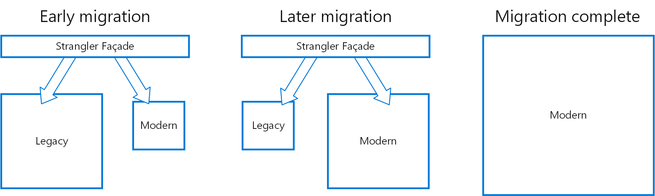
Strangler Pattern
Source: https://docs.microsoft.com/pl-pl/azure/architecture/patterns/strangler

Slide 44
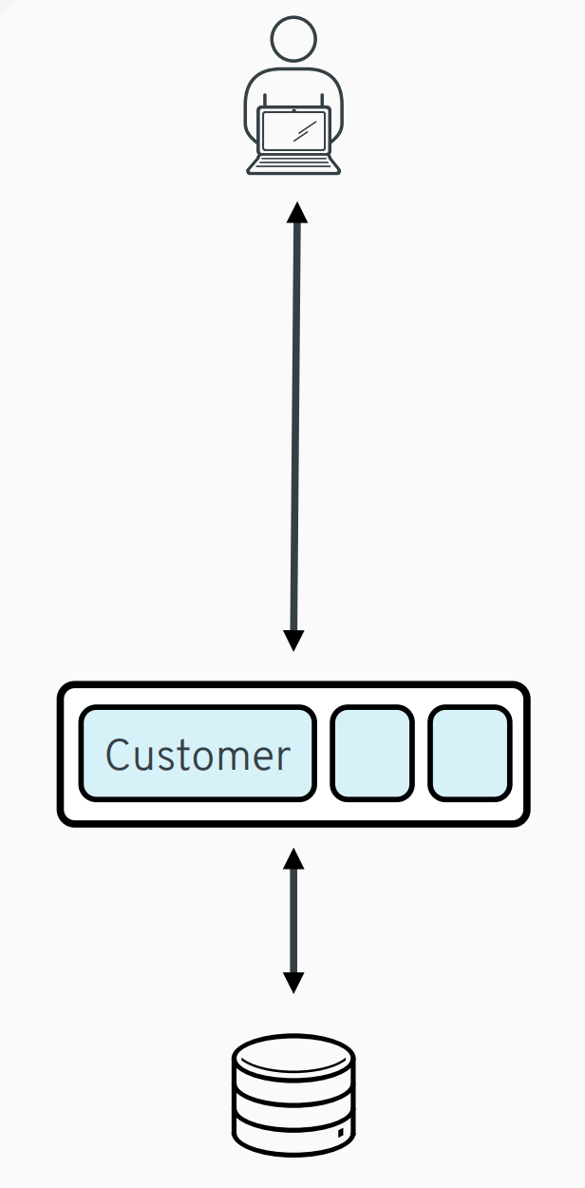
Source: https://speakerdeck.com/gunnarmorling/practical-change-data-streaming-use-cases-with-apache-kafka-and-debezium-qcon-san-francisco-2019

Slide 45
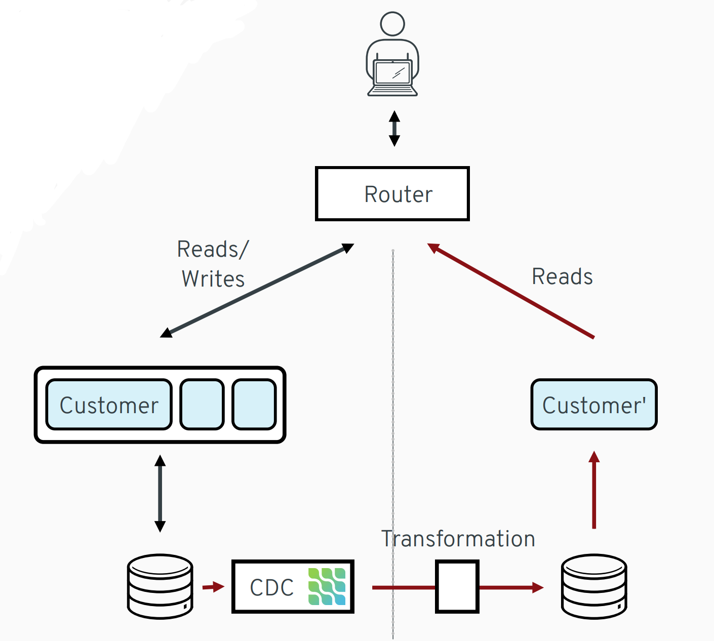
Source: https://speakerdeck.com/gunnarmorling/practical-change-data-streaming-use-cases-with-apache-kafka-and-debezium-qcon-san-francisco-2019

Slide 46
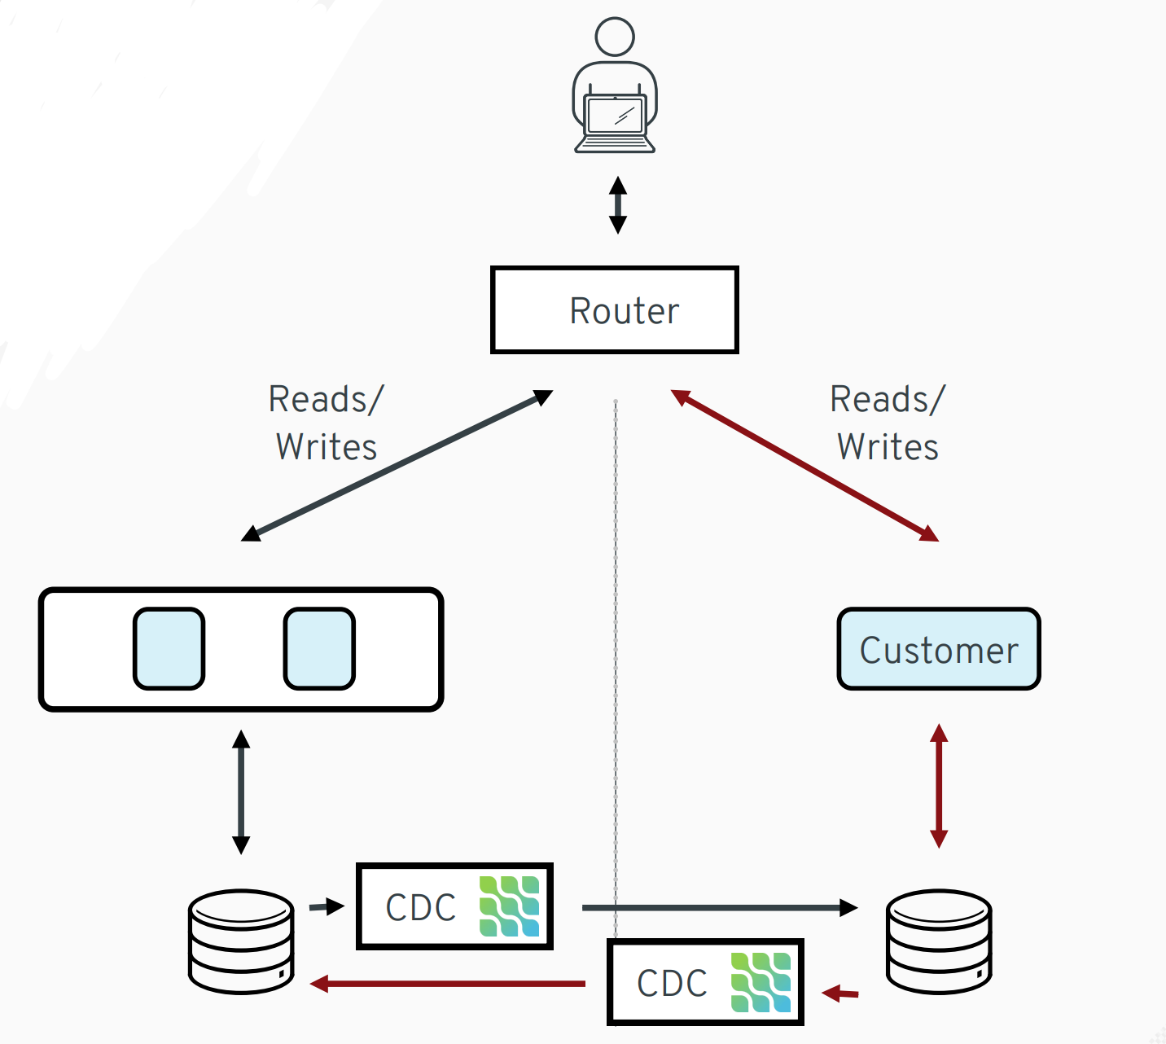
Source: https://speakerdeck.com/gunnarmorling/practical-change-data-streaming-use-cases-with-apache-kafka-and-debezium-qcon-san-francisco-2019

Slide 47

CDC Challenges

Slide 48
Challenges
MySQL – not all DELETE events are visible in CDC – link
LogCompaction on Kafka
Blocking write traffic by locking tables.
Missing ability to trigger dumps on demand.
Stopping log event processing while processing a dump.

Slide 49

Summary

Slide 50
Takeaways
CDC concept is very easy to grasp
CDC enables features like:
Replication
Streaming
Auditing
Decouples services
Debezium is most mature framework on the market, but have a look at DBLog

Slide 51

Q&A

